Slide 1
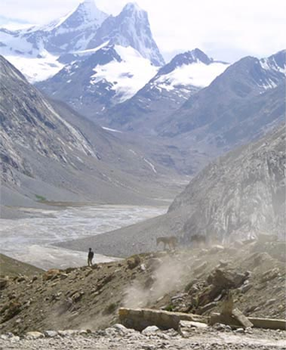
Fellowship of the Heart
Getting Started — the Four Connects, walked around the table on alternating evenings
Evening Series 2026–27 · at the Tittle home · v1.5E DRAFT
All Scripture: ESV · The Companion lesson plans carry the full scripts — these slides carry the room
1
Notes:
DECK TITLE · pre-session · DIVIDER
On screen as the room assembles on night one. All Scripture ESV; the plans carry the scripts; these slides carry the room — and these notes carry you.

Slide 2

SESSION 22
Commissioning the Companions
The exit gate as a witnessed rite — the seniors leave having begun, not finished
Quarter 4: Consolidation & Sending
266
Notes:
S22 · pre-session · DIVIDER
On screen through dinner and as the circle forms. Greet at the door — the slide holds the room. Tonight runs the standard evening clock; dessert after. Single wide circle, open center, no table; keepsake sheets and pens staged on the side table; the physical Lab-date card in the Lead's pocket.

Slide 3

Session 22 — Tonight’s Road
1 Welcome and framing
2 The final rep — the container opened
3 The word over the night
4 The three rules read aloud
5 The covering named
6 The commissioning
7 The first Lab scheduled
8 The Leader Feedback Round — both leaders
9 The final rep — the container closed
267
Notes:
S22 · 7:00–8:30 · LEAD: BOTH LEADERS CIRCLE
BEATS:
1. Name the night: the seniors are commissioned FC1 — an exit gate run as a witnessed rite, not a graduation; nobody is leaving — the gate opens inward, onto a serving place in this body.
2. Four movements: the final rep (container opened and closed from memory), the three rules read aloud, the covering named, the commissioning — with Lab 1 on the calendar before anyone leaves.
3. The seniors lead; the adults confirm and bless; the cohort witnesses.
GUARD: Any unconfirmed sign-off was settled privately weeks ago — NEVER discovered today. If the team somehow arrives unsettled, stop and settle before the session, even at the cost of a delay. Section 6 protocols stand.

Slide 4

Welcome and Framing — a Gate, Not a Graduation
• Last week we commissioned the families. Tonight we commission the Companions — and this is not a graduation. Nobody is leaving; tonight opens a door further in.
• The seniors become FC1 — Formation Companion, Level One: a serving place in this body. Not finishing something — beginning something.
1 The final rep — the container opened and closed from memory, no script
2 The three rules that never bend, read aloud to the whole room
3 The covering named — the adult each new FC1 calls when they are over their head
4 The commissioning — blessing spoken over each one, and the first Leader Lab on the calendar before anyone leaves
268
Notes:
S22 · 7:00–7:08 · LEAD: CONTAINER HOLDER CIRCLE
BEATS:
1. Five minutes total — the small budget is the point; the night is handed over fast.
2. Say the distinction plainly: a graduation sends you out of a room; today opens a door further in — FC1 means a serving place in this body, beginning, not finishing.
3. Name the four movements so the room can follow the architecture — and flag the last one: the Lab date before anyone leaves is the proof today is a beginning.
4. Close: 'Seniors, the room is yours' — lean in one more time, because true things deserve witnesses.

Slide 5
The Final Rep — the Container Opened
• Container fluency is FC1’s spine competency — Safe, Present, Clear, Intentional, from memory, without a script. Tonight is the witness of it, not the exam.
• One senior opens the container whole — welcome, phones, the standing circle, one-word check-in, put out / bring in, the spoken commitment, opening prayer
– “I am here. I am paying attention. I am willing to be moved.”
• Every other senior speaks one condition from memory — in their own words, with one short true story of holding it while leading this year
• One senior is held in reserve — tonight’s close is theirs
• The gate is fluency across the arc, not perfection tonight. A stumble is not a fail.
269
Notes:
S22 · 7:25–7:35 · LEAD: CONTENT PRESENTER CIRCLE
BEATS:
1. One senior opens the full protocol from memory — no script, no cards; the whole room participates as every week.
2. Every other senior speaks one container condition — Safe, Present, Clear, Intentional — in their own words with one true story of holding it while leading, 60–90 seconds each. The closing senior is held in reserve for Block 9.
3. Your whole job: sit still and let them.
CUES: Grace protocol, decided in advance. A freeze: calm, from your seat — 'Take a breath. You have opened this container more times than anyone in this room but me. Start with Safe.' If they cannot continue: stand with them, hand on shoulder, tell the room the truth of their year, and finish it TOGETHER. The gate was passed weeks ago; today is the witness. A stumble is never the story of the night — never mentioned again in any tone but tenderness.

Slide 6
The Word Over the Night
• Count the generations: Paul. Timothy. Faithful ones. Others also. Four generations in a single sentence — and the handing happens “in the presence of many witnesses.” In a room like this one.
• Tonight the third generation stands up in front of the second — and the fourth is already sitting in the room
• 1 Timothy 4:12 — “Let no one despise you for your youth, but set the believers an example in speech, in conduct, in love, in faith, in purity.”
• Tonight this room does the opposite of despising. Then prayer over the seniors.
2 TIMOTHY 2:2
“and what you have heard from me in the presence of many witnesses entrust to faithful men, who will be able to teach others also.”
270
Notes:
S22 · 7:35–7:41 · LEAD: CONTENT PRESENTER CIRCLE
BEATS:
1. Read 2 Timothy 2:2 and 1 Timothy 4:12 from the physical Bible.
2. Frame briefly: count the generations — Paul, Timothy, the faithful, the others also — and notice where the handing happens: in the presence of many witnesses, in a room like this one. Today the third generation stands up, and the fourth is already sitting here.
3. 1 Timothy 4:12: written to a young leader wondering if he was too young — today this room does the opposite of despising.
4. Pray, then move — the movements are waiting.

Slide 7
The Three Rules Read Aloud
• The bright line made public — the whole room hears the boundaries its young leaders keep. These rules protect you and your kids as much as they protect the leaders.
1 A Companion-in-Formation never counts as one of the two adults. “Co-lead” means an adult Companion in the room — not nearby, in the room.
2 A Companion-in-Formation never takes a disclosure. If something heavy surfaces, their only job is to hand it to the adult immediately. They are not a junior counselor.
3 Lead only a block you have first received. See it, then lead it.
• These rules never bend — not for talent, not for maturity, not for a short-handed night. Handing the heavy thing to your adult is the strong, faithful move — never a failure.
271
Notes:
S22 · 7:41–7:47 · LEAD: CONTENT PRESENTER CIRCLE
BEATS:
1. Frame: the whole room hears the boundaries its young leaders keep — not a leash, the frame that lets a sixteen-year-old lead this room and every parent sleep at night.
2. Read the three rules VERBATIM from the handbook: a CiF never counts as one of the two adults; a CiF never takes a disclosure — hands it to the adult immediately; lead only a block you have first received.
3. Optional (team's pre-decided call): the Lead reads each first line and the seniors read them back together.
4. Close the movement: these rules never bend — not for talent, not for a short-handed night; handing the heavy thing over is the strong, faithful move, never a failure.

Slide 8
The Covering Named
• An FC1 never leads uncovered — an adult with a name and a phone number, who has said yes
• A covering that is public is a covering that holds
1 Each senior stands and says it plainly: “When I am over my head, I call _____.”
2 The sign-off confirmed publicly — the parent: “I confirm it.” The Lead Companion: “And I confirm it.”
3 The covering name goes onto the Commissioning Card, there in the circle — ink, not intention
272
Notes:
S22 · 7:47–7:54 · LEAD: CONTENT PRESENTER CIRCLE
BEATS:
1. Frame: an FC1 never leads uncovered; a covering that is public is a covering that holds.
2. Per senior (~90 sec): each stands and says plainly 'When I am over my head, I call ___' — name and relationship; a covering person present stands where they are.
3. Confirm the sign-off aloud: the parent — 'I confirm it' — then the Lead Companion.
4. The senior writes the covering name on their Commissioning Card in the circle — ink, not intention.
GUARD: A deferred sign-off was handled privately in Week 15's week, with a hopeful path — it NEVER surfaces as news today; that senior is honored by name in the blessing block, no explanation to the room.
SUB: The confirmation belongs to those who did the discernment. Covering for the founder, relay his word by name — 'John confirmed it before today; I carry that confirmation' — never as your own judgment.

Slide 9
The Commissioning
1 Each senior stands in the center; their family stands behind them
2 Two Companions speak their prepared blessings — drawn from specific moments of leading: what we saw, what we bless, what we see coming
3 The parent may add one sentence. One. It will be the one the teen remembers.
4 The cohort speaks the Aaronic blessing over the new FC1 — the whole room, slowly, hands extended
5 “[Name], the team commissions you as Formation Companion, Level One. Serve the body. Keep the rules. Call your covering. Watch the signs.”
• Then the charge, once, over all of them — keep your own walk first; keep the three rules when no one is checking; call your covering early, not late; watch the three signs. “FC1 is a real and honorable place to stand… Set the example. Begin.”
273
Notes:
S22 · 7:54–8:10 · LEAD: CONTENT PRESENTER CIRCLE
BEATS:
1. Per senior (~4–5 min): stand center, family behind; two Companions speak prepared blessings from specific leading moments, 1–3 sentences; the parent adds ONE; the cohort speaks the Aaronic; hand them the Commissioning and Limits Cards — serve the body, keep the rules, call your covering, watch the signs.
2. The senior returns to the circle, not a seat apart.
3. Then the charge over them all, brief: own walk first; the rules when no one is checking; covering early, not late; the three signs; FC1 is a real and honorable place to stand.
CUES: Blessing form = one specific witnessed sentence, not a speech. Tears under blessing are the night working — do not rush or rescue.
SUB: Blessings must be their authors' own; the charge is the founder's — read it named as his or speak your own. A covering leader never reads the founder's blessing as their own.

Slide 10
The First Lab Scheduled
• Before anyone reaches for a coat — one piece of business, on purpose, in front of everyone
• The first Leader Lab of the spring serving cycle: [day], [date], [time], [place]. Write it down now.
• The Lab 1 assignment is already set: bring one vital-signs observation from this room, tonight
• “Anyone can hold a beautiful ceremony. The proof that tonight was a gate and not a ceremony is a date on a calendar.” The exit is an entrance.
274
Notes:
S22 · 8:10–8:13 · LEAD: CONTENT PRESENTER CIRCLE
BEATS:
1. Before anyone reaches for a coat: hold up the physical date card and announce Lab 1 of the spring serving cycle — day, date, time, place; new FC1s write it down now.
2. Name their Lab 1 assignment: bring one vital-signs observation from this room today, seen with the lens from the charge.
3. Say the why out loud: anyone can hold a beautiful ceremony — a date on a calendar is the proof today was a gate. These leaders begin in days.
4. One sentence to the younger teens: in a year or two, some of you will stand where these seniors stand — watch how they begin. No promises, no selection talk; just the door left visibly open.

Slide 11
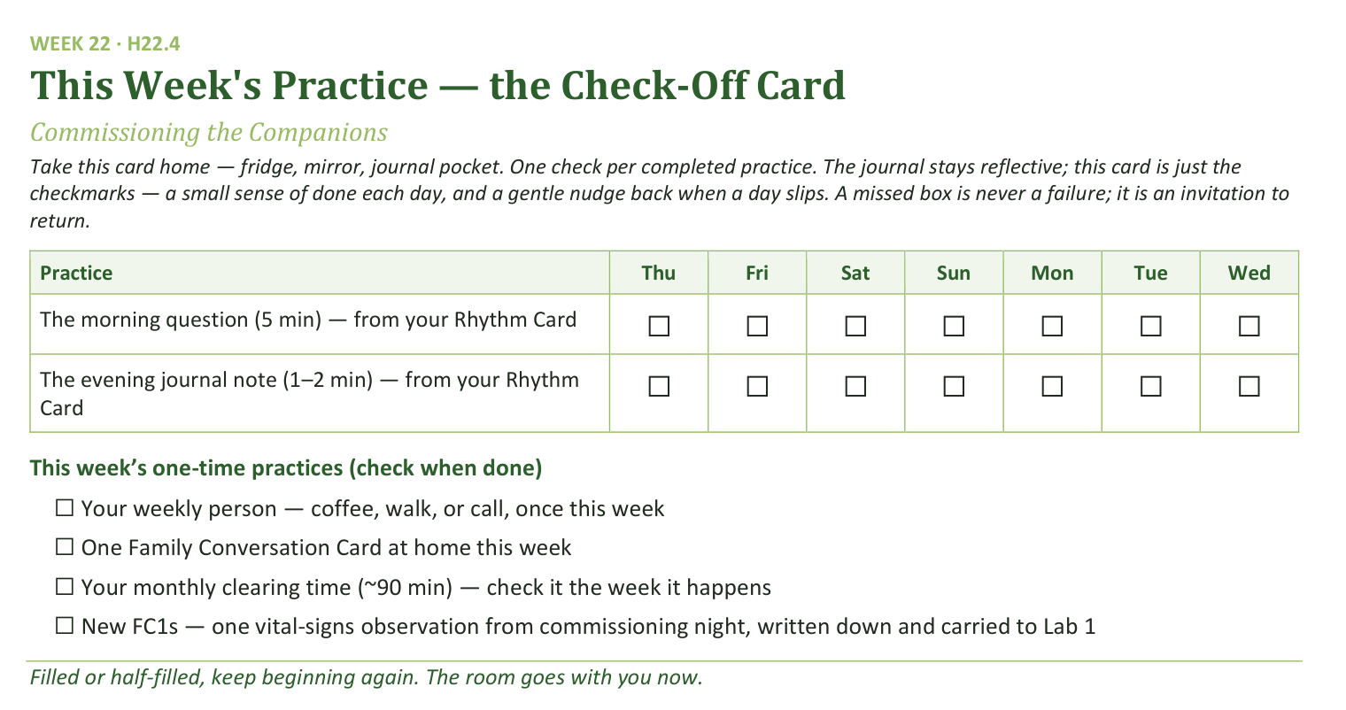
Your Take-Home Card — This Session’s Practice
Handed out now — fridge, mirror, journal pocket.
275
Notes:
S22 · 8:10–8:13 · LEAD: CONTENT PRESENTER CIRCLE
BEATS:
1. Check-off card H22.4: the morning question and the session journal note continue from the Rhythm Card, through the interlude.
2. One-time boxes: the weekly person; one Family Conversation Card at home; the monthly clearing time — and for the new FC1s, the vital-signs observation written down and carried to Lab 1.
3. Keep beginning again — the room goes with you now.

Slide 12
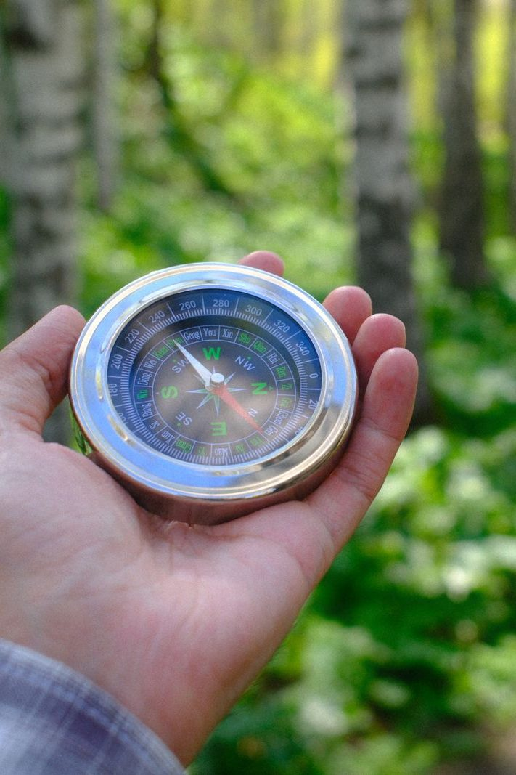
The Leader Feedback Round
• Two rounds, same as every session — the container holder first, then the content presenter: three things each
– “What I think went well tonight: ______”
– “What I’d do differently next time: ______”
– “If I were to teach tonight’s process to someone, I would tell them: ______”
• Then the room — the same two questions about tonight
• The leaders receive without defending — “thank you” is the whole response
276
Notes:
S22 · 8:24–8:28 · LEAD: BOTH LEADERS CIRCLE
BEATS:
1. The new FC1s answer first: what went well, what they'd do differently — and one last time before it becomes their question to carry: what would you tell whoever teaches this. A sentence or two each.
2. The adult answers for the parts the adults carried; then the room, two or three voices; received undefended — 'thank you' is the whole response.
3. May well be dropped today — the rite itself is often what the energy needs; dropping it twice running goes to the debrief.

Slide 13
The Final Rep — the Container Closed
• The reserved senior closes the container from memory — the standing circle, the one-word landing, the one thing, the one practice, the blessing round, the closing prayer and sending
• The rite that opened in a senior’s voice ends in a senior’s voice — the last words of Getting Started are spoken by the generation it raised
• If the senior sends the room, the room is sent — nothing is added after
• After: the signing — everyone signs each new FC1’s keepsake, the way you sign a Bible flyleaf. Then dessert. Stay.
277
Notes:
S22 · 8:13–8:20 · LEAD: CONTENT PRESENTER CIRCLE
BEATS:
1. The reserved senior closes the full protocol from memory: standing circle, one-word landing, the one thing, the one practice, the blessing round, closing prayer and sending.
2. Expect the blessing round to lean hard toward the FC1s — give it room; the closing senior was told beforehand: receive it, then finish. Ending well under a full heart is the most FC1 thing they will do all night.
3. Resist adding ANYTHING after the senior's sending — the last words of the series belong to the generation it raised; the team's silence is the loudest confirmation in the room.
4. After: keepsake signing at the side table — names as witnesses; nobody leaves without signing. Dessert, lingering; stay — the younger teens near the seniors are the pipeline forming in real time.

